Slide 1
SSWT ZC467
Computer Networks
Contact Session – 5
Prabhu Subramanian

Slide 2

IMP Note to Self

Slide 3
Agenda
CH5.1 = Multiplexing, Demultiplexing
CH5.2 = Sliding Window
CH5.3 = Flow and Error control; connectionless and connection oriented

Slide 4
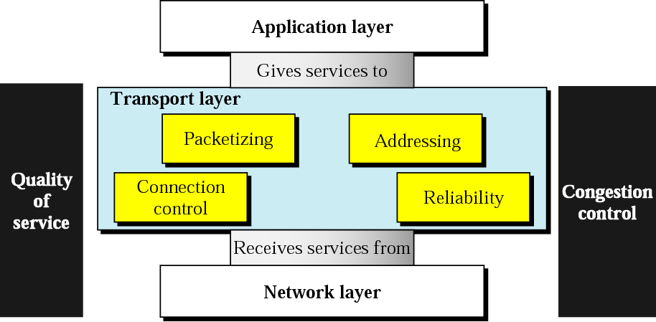
Position of transport layer

Slide 5
Packetizing
Transport layer create packet from the message received by the application layer
Packetizing - divides long message into smaller ones smaller ones are encapsulated into the data field of the TL packet and headers are added

Slide 6
Connection Control
Connection-oriented delivery
    Establishes virtual path between sender & receiver
    Packets may travel in of order
    Transparent to communication in both direction
Connectionless Delivery
    Treats each packet independently
    No connection

Slide 7
ADDRESSING
Packet carrying the request must specify to which server program the request must be delivered
PROVIDING RELIABILITY
Flow control
Error control

Slide 8
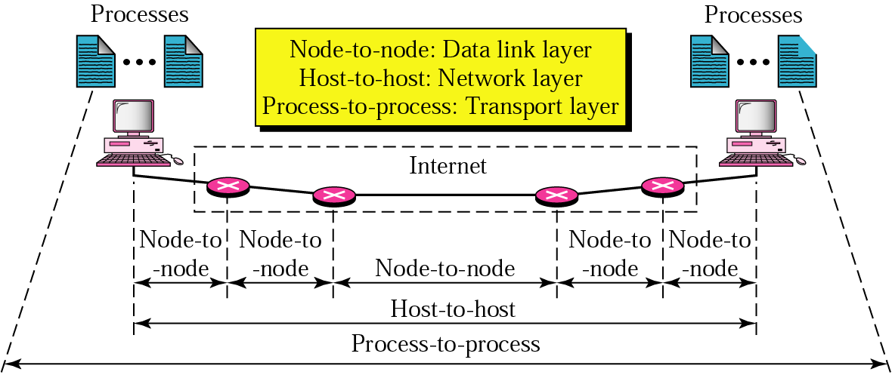
Types of data deliveries

Slide 9
Transport services and protocols
provide logical communication between app processes running on different hosts
transport protocols run in end systems
  send side: breaks app messages into segments, passes to network layer
  rcv side: reassembles segments into messages, passes to app layer
more than one transport protocol available to apps
  Internet: TCP and UDP
application
transport
network
data link
physical
network
data link
physical
network
data link
physical
network
data link
physical
logical end-end transport
network
data link
physical
network
data link
physical
application
transport
network
data link
physical

Slide 10
Port numbers for Internet model
16 bit numbers ( between 0 and 65,535)
Client Program - ephemeral port - chosen randomly - transport layer software running on the client host
Server program - well known port numbers- Universal port numbers

Slide 11
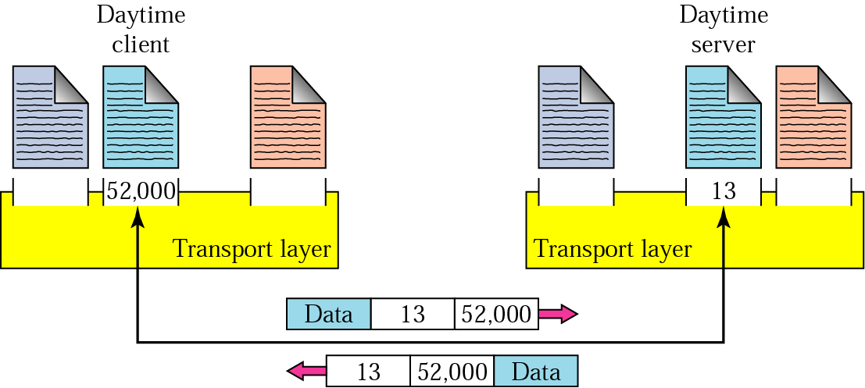
Port numbers

Slide 12
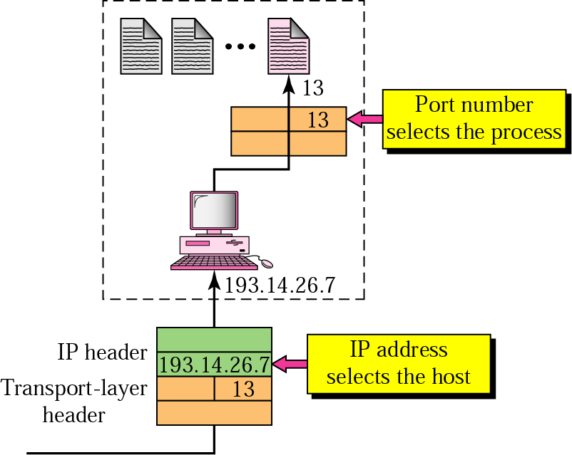
IP addresses versus port numbers

Slide 13
Transport Layer
Multiplexing, Demultiplexing
Sliding Window
Flow and Error control; connectionless and connection oriented

Slide 14

















Transport services and protocols
application
transport
network
data link
physical
provide logical communication between app processes running on different hosts
transport protocols run in end systems
  send side: breaks app messages into segments, passes to network layer
  rcv side: reassembles segments into messages, passes to app layer
more than one transport protocol available to apps
  Internet: TCP and UDP
logical end-end transport
application
transport
network
data link
physical

Slide 15












Two principal Internet transport protocols
application
transport
network
data link
physical
TCP: Transmission Control Protocol
  reliable, in-order delivery
  congestion control
  flow control
  connection setup
UDP: User Datagram Protocol
  unreliable, unordered delivery
  no-frills extension of “best-effort” IP
services not available:
  delay guarantees
  bandwidth guarantees
mobile network
national or global ISP
logical end-end transport
local or regional ISP
home network
content
provider
network
application
transport
network
data link
physical
datacenter
network
enterprise
network

Slide 16
Transport Layer Actions
Sender:
application
application
is passed an application-layer message
app. msg
determines segment header fields values
T_{h}
transport
app. msg
transport
T_{h}
creates segment
network (IP)
network (IP)
passes segment to IP
link
link
physical
physical

Slide 17
Transport Layer Actions
Receiver:
application
receives segment from IP
application
checks header values
transport
transport
app. msg
extracts application-layer message
network (IP)
network (IP)
demultiplexes message up to application via socket
link
link
physical
physical
app. msg
T_{h}

Slide 18
Multiplexing/Demultiplexing
HTTP
Transport
Layer
FTP
Transport
Layer
Telnet
Network
Layer
Network
Layer
Use same communication channel between hosts for several logical communication processes
How does Mux/DeMux work?
  Sockets: doors between process & host
  UDP socket: (dest. IP, dest. Port)
  TCP socket: (src. IP, src. port, dest. IP, dest. Port)

Slide 19





Multiplexing / Demultiplexing
HTTP server
client
application
application
HTTP msg
transport
transport
network
transport
network
link
network
link
physical
link
physical
physical

Slide 20
Multiplexing / Demultiplexing
HTTP server
client
application
application
HTTP msg
transport
H_{t}
HTTP msg
transport
network
transport
network
link
network
link
physical
link
physical
physical

Slide 21
Multiplexing / Demultiplexing
HTTP server
client
application
application
HTTP msg
transport
H_{t}
HTTP msg
H_{n}
H_{t}
network
transport
HTTP msg
transport
network
link
network
link
physical
link
physical
physical

Slide 22
Multiplexing / Demultiplexing
HTTP server
client
application
application
transport
transport
network
transport
network
link
network
link
physical
link
physical
physical
H_{n}
H_{t}
HTTP msg

Slide 23

Multiplexing / Demultiplexing
HTTP server
client₁
client₂
application
P-client₁
P-client₂
application
transport
transport
network
transport
network
link
network
link
physical
link
physical
physical

Slide 24
Multiplexing / Demultiplexing
multiplexing at sender:
demultiplexing at receiver:
handle data from multiple
sockets, add transport header (later used for demultiplexing)
use header info to deliver
received segments to correct
socket
application
application
P1
P2
application
socket
P3
transport
P4
process
transport
network
transport
network
link
network
link
physical
link
physical
physical

Slide 25
How demultiplexing works
host receives IP datagrams
  each datagram has source IP address, destination IP address
  each datagram carries one transport-layer segment
  each segment has source, destination port number
host uses IP addresses & port numbers to direct segment to appropriate socket
32 bits
source port #
dest port #
other header fields
application
data
(payload)
TCP/UDP segment format

Slide 26
Connectionless demux
UDP socket identified by two-tuple:
  (dest IP address, dest port number)
When host receives UDP segment:
  checks destination port number in segment
  directs UDP segment to socket with that port number
IP datagrams with different source IP addresses and/or source port numbers directed to same socket

Slide 27
Connection-oriented demux
TCP socket identified by 4-tuple:
  source IP address
  source port number
  dest IP address
  dest port number
recv host uses all four values to direct segment to appropriate socket
Server host may support many simultaneous TCP sockets:
  each socket identified by its own 4-tuple
Web servers have different sockets for each connecting client
  non-persistent HTTP will have different socket for each request

Slide 28
Principles of Reliable Data Transfer
important in application, transport, and link layers
Sending
Process
Receiving
Process
Sending
Process
Receiving
Process
Application Layer
Transport Layer
Reliable Channel
RDT protocol
(sending side)
RDT protocol
(receiving side)
Network Layer
Unreliable Channel
characteristics of unreliable channel will determine complexity of reliable data transfer protocol (rdt)

Slide 29

Principles of reliable data transfer
sending process
receiving process
application
data
data
transport
reliable channel
reliable service abstraction
Notes:
note arrows through reliable data transfer channel is just one way – reliably send from sender to receiver

Slide 30

Principles of reliable data transfer
sending process
receiving process
sending process
receiving process
application
data
data
application
data
data
transport
transport
reliable channel
sender-side of
reliable data transfer protocol
receiver-side
of reliable data transfer protocol
reliable service abstraction
transport
network
unreliable channel
reliable service implementation
Notes:
Spend some time talking about how its to the sender and receiver side protocol that IMPLEMENTS reliable data transfer
Communication over unreliable channel is TWO-way: sender and receiver will exchange messages back and forth to IMPLEMENT one-way reliable data transfer

Slide 31
Principles of reliable data transfer
sending process
receiving process
application
data
data
transport
sender-side of
reliable data transfer protocol
receiver-side
of reliable data transfer protocol
Complexity of reliable data transfer protocol will depend (strongly) on characteristics of unreliable channel (lose, corrupt, reorder data?)
transport
network
unreliable channel
reliable service implementation
Notes:
So we have a sender side and a receiver side. How much work they’ll have to do depends on the IMPAIRMENTS introduced by channel – if the channel is perfect – no problem!

Slide 32

Principles of reliable data transfer
sending process
receiving process
application
data
data
transport
sender-side of
reliable data transfer protocol
receiver-side
of reliable data transfer protocol
Sender, receiver do not know the “state” of each other, e.g., was a message received?
unless communicated via a message
transport
network
unreliable channel
reliable service implementation
Notes:
Here’s a point of view to keep in mind – it’s easy for US to look at sender and receiver together and see what is happening. OH – that message sent was lost.
But think about it say from senders POV How does the sender know if its transmitted message over the unreliable channel got though?? ONLY if receiver somehow signals to the sender that it was received.
The key point here is that one side does NOT know what is going on at the other side – it’s as if there’s a curtain between them. Everything they know about the other can ONLY be learned by sending/receiving messages.
Sender process wants to make sure a segment got through. But it can just somehow magically look through curtain to see if receiver got it. It will be up to the receiver to let the sender KNOW that it (the receiver) has correctly received the segment.
How will the sender and receiver do that – that’s the PROTOCOL.
Before starting to develop a protocol, let’s look more closely at the interface (the API if you will)

Slide 33
Reliable data transfer protocol (rdt): interfaces
rdt_send(): called from above, (e.g., by app.). Passed data to deliver to receiver upper layer
deliver_data(): called by rdt to deliver data to upper layer
sending process
receiving process
rdt_send()
data
data
deliver_data()
data
sender-side
implementation of rdt reliable data transfer protocol
receiver-side
implementation of rdt reliable data transfer protocol
packet
udt_send()
Header
data
Header
data
rdt_rcv()
unreliable channel
udt_send(): called by rdt
to transfer packet over
unreliable channel to receiver
rdt_rcv(): called when packet arrives on receiver side of channel
Bi-directional communication over unreliable channel

Slide 34
Reliable data transfer: getting started
We will:
incrementally develop sender, receiver sides of reliable data transfer protocol (rdt)
consider only unidirectional data transfer
  but control info will flow in both directions!
use finite state machines (FSM) to specify sender, receiver
event causing state transition
actions taken on state transition
state: when in this “state” next state uniquely determined by next event
state
1
state
2
event
actions
Notes:
SO let’s get started in developing our reliable data transfer protocol, which we’ll call rdt (need a good acronym for protocol – like HTTP, TCP, UDP, IP)
Bullet points 1 and 2
NOW if we are going to develop a protocol, so we’ll need some way to SPECIFY a protocol. How do we do that?
We could write text, but as all know, that’s prone to misinterpretation, and might be incomplete. You might write a specification, and then think “oh yeah – I forgot about that case”
What we need is more formal way to specify a protocol. In fact, with a formal specification there may be ways to PROVE PROPERTIES about a specification. But that’s an advanced topic we won’t get into here. We’ll start here by adopting a fairly simple protocol specification technique known as finite state machines (FSM)
And as the name might suggest, a central notion of finite state machines is the notion of STATE
<talk about state>

Slide 35
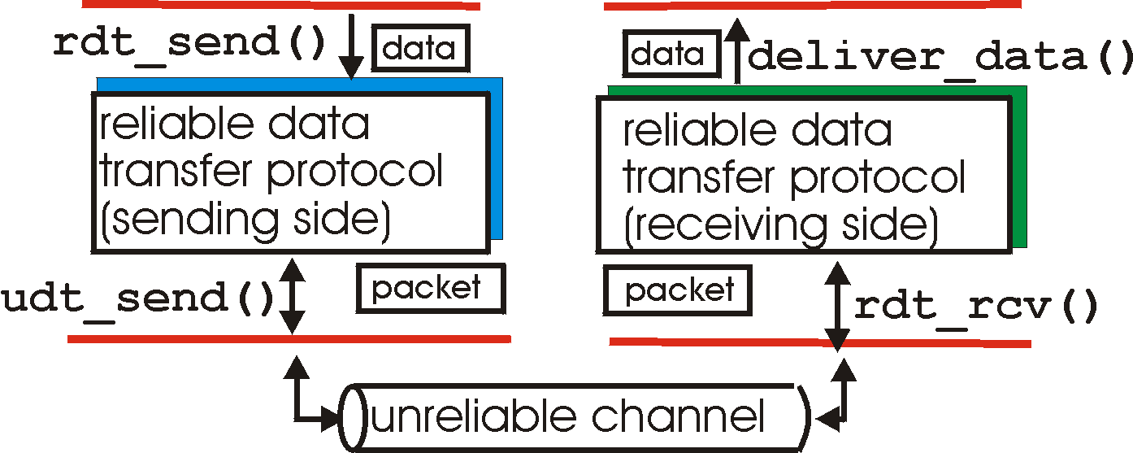
Reliable data transfer: getting started
rdt_send(): called from above, (e.g., by app.). Passed data to
deliver to receiver upper layer
deliver_data(): called by rdt to deliver data to upper
send
side
receive
side
udt_send(): called by rdt,
to transfer packet over
unreliable channel to receiver
rdt_rcv(): called when packet arrives on rcv-side of channel

Slide 36
Reliable Data Transfer: FSMs
We’ll:
incrementally develop sender, receiver sides of reliable data transfer protocol (rdt)
consider only unidirectional data transfer
  but control info will flow on both directions!
use finite state machines (FSM) to specify sender, receiver

Slide 37
rdt3.0 sender
rdt_send(data
rdt_rcv(rcvpkt) &&
( corrupt(rcvpkt) ||
isACK(rcvpkt,1) )
sndpkt = make_pkt(0, data, checksum)
udt_send(sndpkt)
start_timer
rdt_rcv(rcvpkt)
Λ
Λ
Wait for
call 0from above
Wait for ACK0
timeout
rdt_rcv(rcvpkt)
&& notcorrupt(rcvpkt)
&& isACK(rcvpkt,1)
rdt_rcv(rcvpkt)
&& notcorrupt(rcvpkt)
&& isACK(rcvpkt,0)
stop_timer
stop_timer
Wait for ACK1
Wait for
call 1 from above
timeout
udt_send(sndpkt)
start_timer
rdt_rcv(rcvpkt)
rdt_send(data)
Λ
rdt_rcv(rcvpkt) &&
( corrupt(rcvpkt) ||
isACK(rcvpkt,0) )
sndpkt = make_pkt(1, data, checksum)
udt_send(sndpkt)
start_timer
Λ

Slide 38
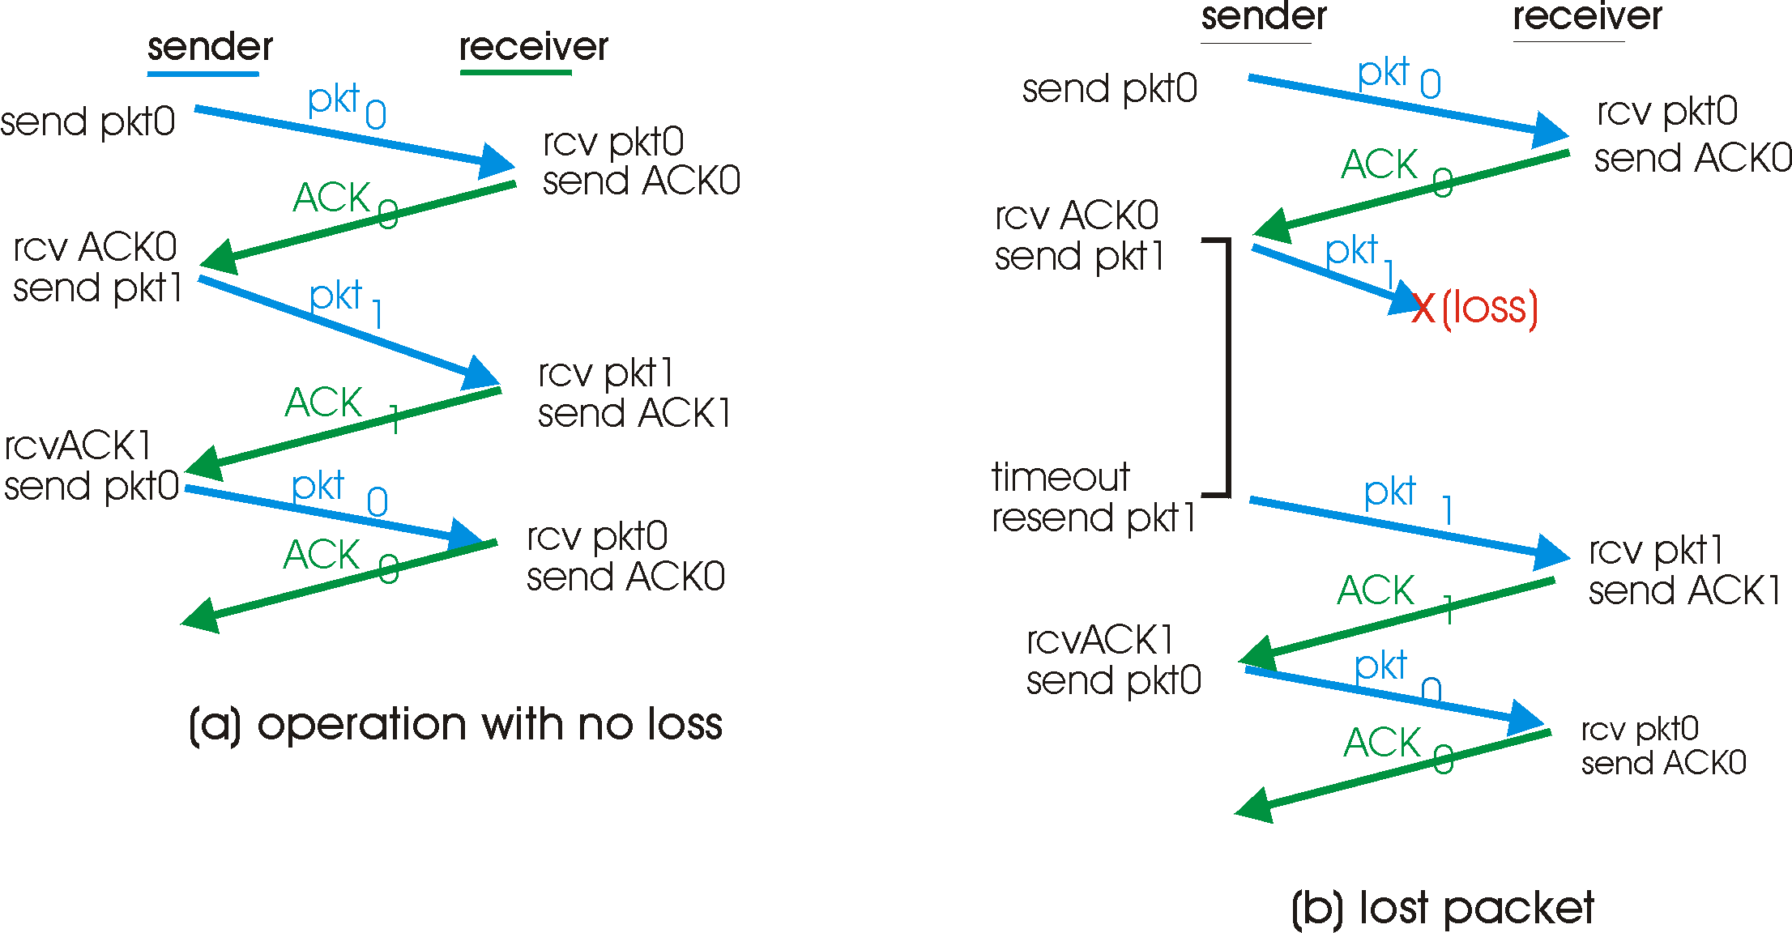
rdt3.0 in action

Slide 39
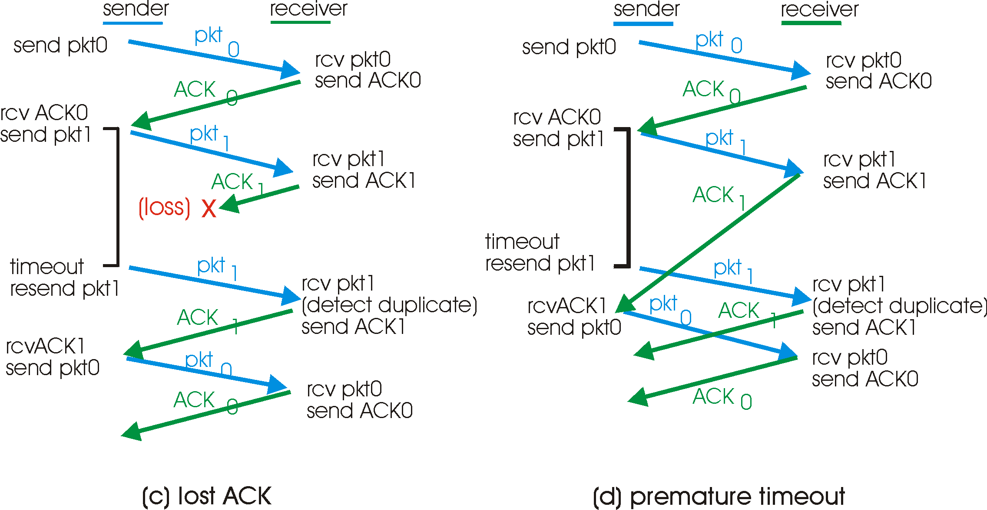
rdt3.0 in action

Slide 40
rdt3.0: stop-and-wait operation
sender
receiver
first packet bit transmitted, t = 0
first packet bit arrives
RTT
last packet bit arrives, send ACK
ACK arrives, send next
packet, t = RTT + L / R

Slide 41
Pipelining: Increased Utilization
sender
receiver
last bit transmitted, t = L / R
first packet bit arrives
RTT
Connectionless demux: example
last packet bit arrives, send ACK
ACK arrives, send next
packet, t = RTT + L / R
Increase utilization
by a factor of 3!

Slide 42
Pipelining: Motivation
Stop-and-wait allows the sender to only have a single unACKed packet at any time
example: 1 Mbps link (R), end-2-end round trip propagation delay (D) of 92ms, 1KB packet (L):
T
=
L (packet length in bits)
8kb/pkt
transmit
=
= 8 ms
R (transmission rate, bps)
10**3 kb/sec
  1KB pkt every 100 ms -> 80Kbps throughput on a 1 Mbps link

Slide 43
Pipelined protocols
Pipelining: sender allows multiple, “in-flight”, yet-to-be-acknowledged pkts
  range of sequence numbers must be increased
  buffering at sender and/or receiver
Two generic forms of pipelined protocols
  go-Back-N
  selective repeat

Slide 44
Go-Back-N
Allow up to N unACKed pkts in the network
  N is the Window size
Sender Operation:
  If window not full, transmit
  ACKs are cumulative
  On timeout, send all packets previously sent but not yet ACKed.
  Uses a single timer – represents the oldest transmitted, but not yet ACKed pkt

Slide 45
4 intervals in the range of sequence numbers
1. [0, base-1] - packets that have already been transmitted and acknowledged
2. [base,nextsequence-1] - packets that have been sent but not yet ack
3. [nextseqnum, base+N-1] - packets that can be sent immediately
4. Seqnum > N+1 cannot be used until unack packet in the pipelimne is ack

Slide 46
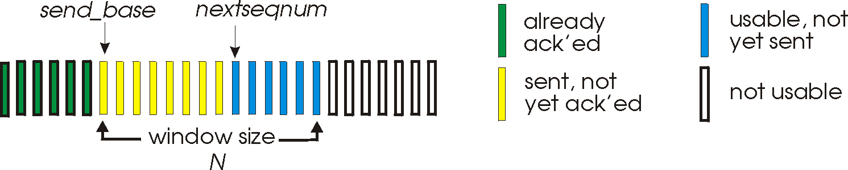
Go-Back-N
Sender:
k-bit seq # in pkt header
“window” of up to N, consecutive unack’ed pkts allowed
ACK(n): ACKs all pkts up to, including seq # n - “cumulative ACK”
  may receive duplicate ACKs (see receiver)
timer for each in-flight pkt
timeout(n): retransmit pkt n and all higher seq # pkts in window

Slide 47
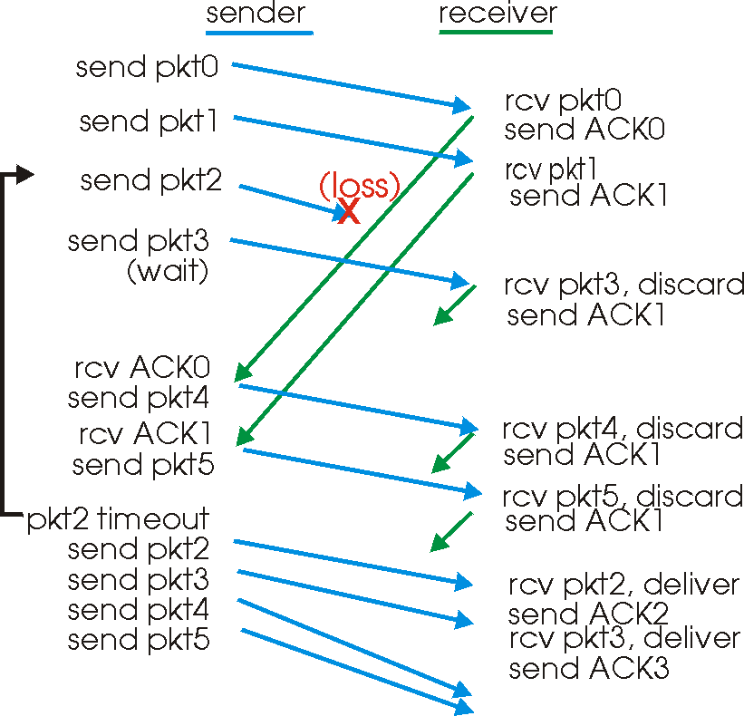
GBN in action

Slide 48
Selective Repeat
receiver individually acknowledges all correctly received pkts
  buffers pkts, as needed, for eventual in-order delivery to upper layer
sender only resends pkts for which ACK not received
  sender timer for each unACKed pkt
sender window
  N consecutive seq #’s
  again limits seq #s of sent, unACKed pkts

Slide 49
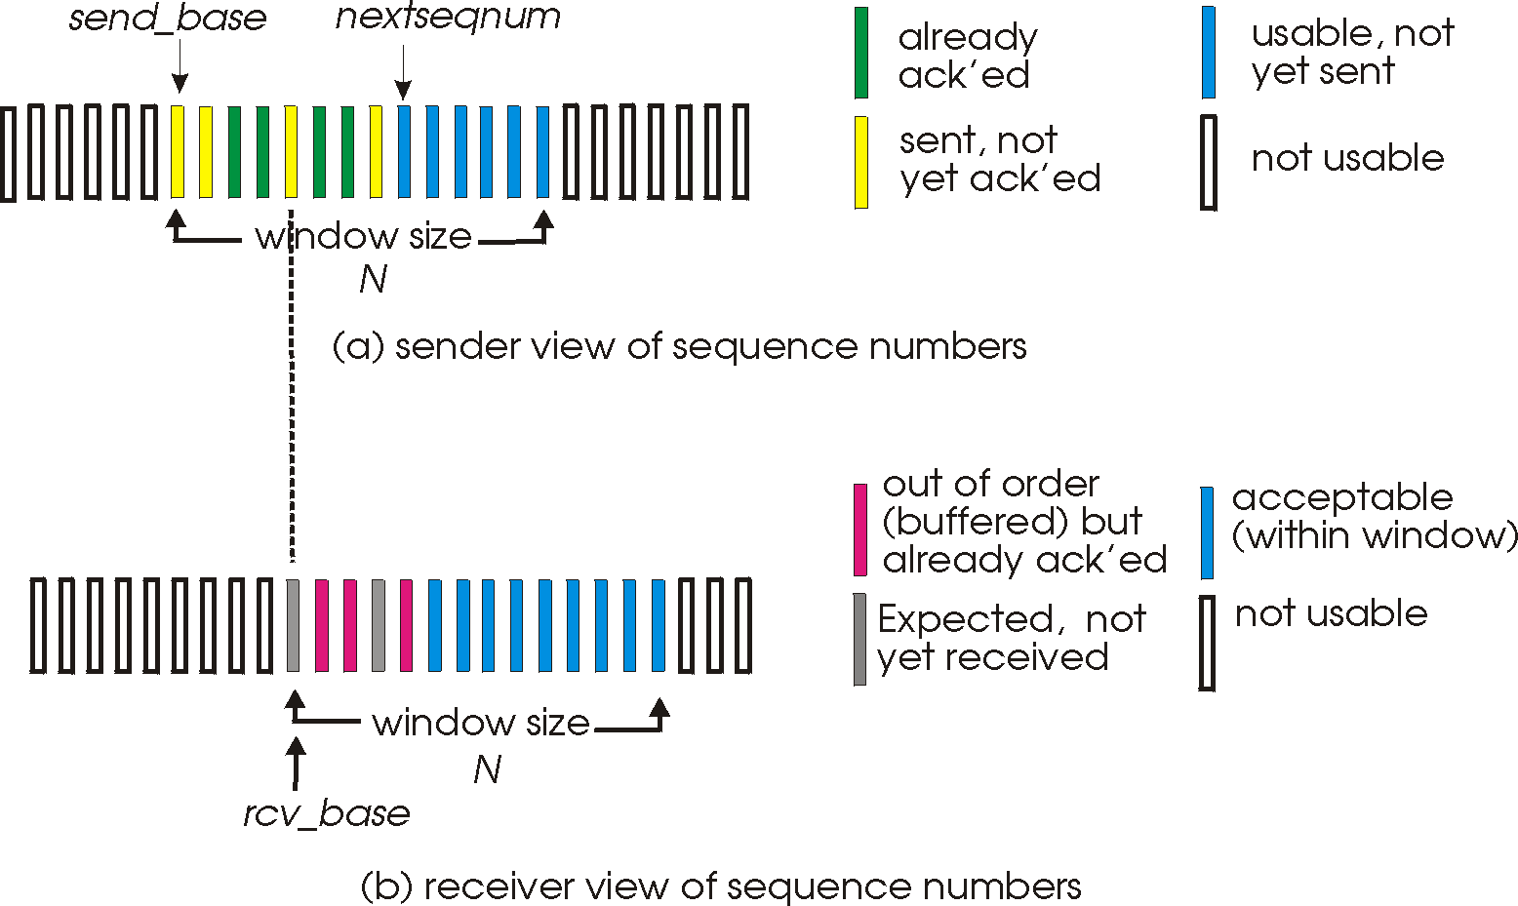
Selective repeat: sender, receiver windows

Slide 50
Selective repeat
data from above :
if next available seq # in window, send pkt
timeout(n):
resend pkt n, restart timer
ACK(n) in [sendbase,sendbase+N]:
mark pkt n as received
if n smallest unACKed pkt, advance window base to next unACKed seq #
pkt n in [rcvbase, rcvbase+N-1]
send ACK(n)
out-of-order: buffer
in-order: deliver (also deliver buffered, in-order pkts), advance window to next not-yet-received pkt
pkt n in [rcvbase-N,rcvbase-1]
ACK(n)
otherwise:
ignore

Slide 51
Selective Repeat Example
PKT0
0123 456789
PKT1
PKT2
0 1234 56789
PKT3
01 2345 6789
ACK0
ACK1
0 1234 56789
ACK2
0 1234 56789
ACK3
PKT4
01234 5678 9
Time-Out
PKT1
ACK4
ACK1
01234 5678 9
Sender
Receiver

Slide 52
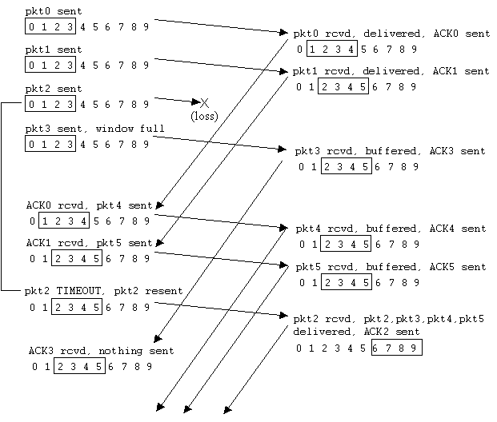
Another Example

Slide 53
GBN in action

Slide 54


